Slide 1
Efficiency & Optimizations

Slide 2
Efficiency & optimizations
GPUs are powerful
They’re also complex
And need to be used correctly
Or suffer very obvious performance degradation
Your graphics API does a lot of the heavy lifting
Managing GPU memory
Handling resource residency
Performing CPU/GPU synchronization
However, inefficient code still has a huge impact

Slide 3
Topics (no particular order)
Drawing fewer objects
Drawing more efficiently
Less CPU → GPU transfer
Fewer render-state / bound-resource swaps
Optimizing shader code

Slide 4
Drawing Fewer Objects

Slide 5

Frustum culling
Only draw the objects you can see!
Horizon Zero Dawn – Frustum Culling

Slide 6
Implementing frustum culling
Performed in C++
Test objects against camera frustum bounds
Might be overkill for 1000’s of very small objects
Make sure this test is not slower than just drawing!
Often optimized with scene partitioning
Octree
Binary space-partitioning (BSP) tree
Bin/grid system

Slide 7
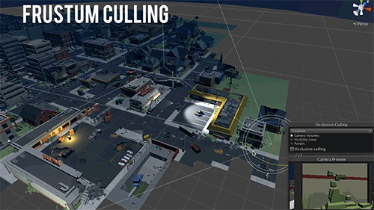
Occlusion culling
Don’t draw what’s blocked by closer objects
Frustum vs. Occlusion culling

Slide 8
Implementing occlusion culling
Can be done in pure C++ or with GPU’s help
C++ method:
Test bounds of further objects against closer ones
Don’t draw objects that are “occluded”
GPU method:
Hardware occlusion queries
Use GPU to determine if any pixels would render
Careful! These can potentially stall the pipeline!

Slide 9
Drawing More Efficiently

Slide 10

Drawing more efficiently
We’ll look at two techniques
Static batching
Make one large mesh out of smaller, similar entities
Instanced rendering
Tell the GPU how many copies of a mesh to draw

Slide 11

Static batching
Use when you have:
Multiple entities
Which never move (they’re static)
All using the same material
At load time:
Make a copy of each object’s vertices
Apply final world matrix to each
Combine into one large vertex buffer
Render with a single draw call!

Slide 12


Static batching example
At start up, each set of static objects have their vertices combined into a single vertex buffer
Batch 1: Christmas trees
Batch 2: Houses
Batch 3: Palm trees
Total draw calls: 3

Slide 13
Static batching drawbacks
Renders whole batch at once
Can’t cull pieces of it
Since it’s one draw call
Vertex buffer can get large
Not inherently bad
But each vertex must be transformed
Even if off screen

Slide 14
Instanced rendering
Use when you have:
Multiple entities
With the same mesh & material
Tell the GPU to render N instances
As you call Draw()
API takes care of duplicating vertex work
Requires multiple world matrices
Must collect them in C++
Somehow access them in vertex shader

Slide 15
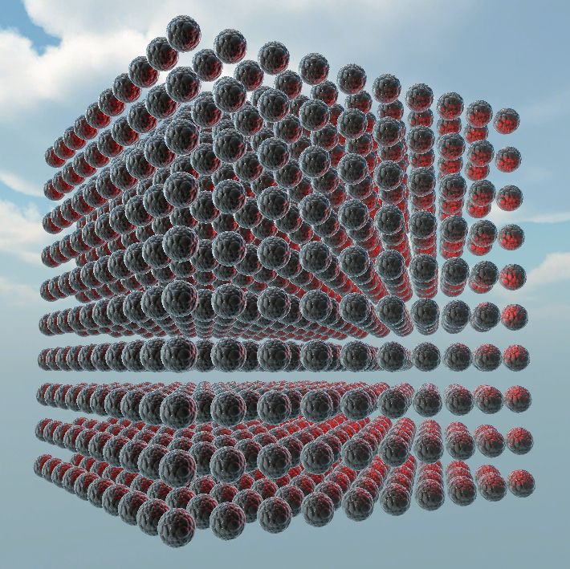
Instanced rendering example
All drawn with one draw call →
See Instanced Rendering slides & demo for details

Slide 16
Instanced rendering drawbacks
Not useful when drawing a single object
Not just a feature you “turn on”
Needs adjustments to shader & render process
Need a renderer to manage instances
Needs to group similar objects
Collect their world matrices
Copy to appropriate buffer on GPU

Slide 17
Less CPU → GPU Transfer

Slide 18


Less data transfer
GPU data transfer takes time
Slower than copying C++ variables
Asynchronous hardware needs to synchronize
We’ll look at two optimizations:
Organize cbuffers by update frequency
Have multiple cbuffers per shader
Update them as infrequently as possible
Standardize cbuffers across shaders

Slide 19
Basic cbuffer example
You might have a cbuffer like this:
cbuffer ExternalData : register(b0)
{
matrix world;
matrix view;
matrix projection;
float4 color;
}
How do we improve this?
Split it into multiple cbuffers!
Wait, what?

Slide 20

Multiple cbuffers
Note: Doesn’t magically improve performance
So how does it help?
Knowns:
We want to send less data to GPU
We send one cbuffer worth of data at a time
Solution:
Group cbuffer data by update frequency
Update each cbuffer as infrequently as possible

Slide 21
Let’s look at our cbuffer again
cbuffer ExternalData : register(b0)
{
matrix world;
matrix view;
matrix projection;
float4 color;
}
How do we improve this?
Changes for every object
Change once per frame
Changes for every material

Slide 22
Cbuffers organized by update freq.
cbuffer PerObject : register(b0)
{
matrix world;
}
cbuffer PerMaterial : register(b1)
{
float4 color;
}
cbuffer PerFrame : register(b2)
{
matrix view;
matrix projection;
}
Copy data before drawing each entity
Only copy data when swapping materials
Copy this data exactly once per frame, at the beginning of Draw()

Slide 23
Multiple cbuffers & SimpleShader
SimpleShader was built to support this!
You’ve been calling CopyAllBufferData()
This loops through all cbuffers
Copies the CPU side data to GPU
Instead, call CopyBufferData(string name)
Copies the specified cbuffer’s data
Allows you to control exactly when copies occur!

Slide 24
Standardize cbuffers across shaders
Often, different shaders need the same data
And that data might not change very often
Maybe only once per frame
Why copy it more than once?
Solution: put the same cbuffer in the same register across all of your shaders
Copy the data to it once
For the entire frame

Slide 25
Standardizing cbuffers - example
Shader 1
cbuffer PerFrame : register(b2)
{
matrix view;
matrix projection;
}
Shader 2
cbuffer PerFrame : register(b2)
{
matrix view;
matrix projection;
}
Make one ID3D11Buffer* for this cbuffer
Set it to vertex shader cbuffer slot 2
Copy data to it once per frame
Note: Need to work around SimpleShader a little here

Slide 26
Fewer Render-State / Bound-Resource Swaps

Slide 27

Each of these changes the pipeline
Binding resources
PSSetShader()
IASetIndexBuffer()
IASetVertexBuffers()
VSSetConstantBuffers()
OMSetRenderTargetViews()
PSSetShaderResourceViews()
Etc.
Changing render states
RSSetState()
OMSetBlendState()
OMSetDepthStencilState()
Etc.

Slide 28

Changes to the pipeline
Every change has a cost
You want to minimize that cost
This means less swapping of resources/states
Great! How?

Slide 29

Minimizing swaps
Sort your objects
By the resource swap you want to minimize
Do this before drawing each frame
Which resource should be swapped the least?
Vertex buffers?
Textures?
Shaders?
Not always a definitive answer!

Slide 30
Minimizing swaps - example
Sort by the texture each material is using
Set texture 1
Draw everything that uses texture 1
Set texture 2
Draw everything that uses texture 2
Etc.

Slide 31

Which resource is most expensive?
Vertex buffers?
Textures?
Shaders?
Render states?
Not always a definitive answer!
Depends on multiple factors
Worth benchmarking your own engine

Slide 32
Swapping - Rules of thumb
Blend state swapping? That’s easy
Always draw all opaque objects first
Then the sky
Then transparent objects
Sorting by material is probably worthwhile
Minimizes texture and some shader swaps
Sorting by depth can minimize overdraw
Drawing closer objects before farther ones
But this conflicts with sorting by materials!

Slide 33
Optimizing Shader Code

Slide 34
Optimizing shader code
Shader compilers will aggressively:
Remove unnecessary variables
Unroll your loops
Flatten your if statements
All of this is in an attempt to optimize your code for the hardware (GPU)
However, there is still much more we can do!

Slide 35

Low-level thinking
For maximum performance…
Need to do the least amount of work possible
To get the desired results
This means…
Understanding what your code is doing
And how best to simplify it
Great talk on shader optimizing
Low-level Thinking in High-level Shading Languages
From GDC 2013

Slide 36
Computers are fast, right?
Sure...
But you’re shading potentially millions of pixels
Per frame!
Small optimizations can cascade into large performance gains if done correctly
We’ll look at some examples

Slide 37
Simple optimization example
// Perform two lighting equations
float light1 = dot(normalize(input.normal), normalize(-lightDir1));
float light2 = dot(normalize(input.normal), normalize(-lightDir2));
Improvement:
Don’t normalize input.normal twice!
Do it once and store the result!
// Perform two lighting equations
input.normal = normalize(input.normal);
float light1 = dot(input.normal, normalize(-lightDir1));
float light2 = dot(input.normal, normalize(-lightDir2));

Slide 38
Optimizing math
// Perform final light calc
float3 result = lightColor.rgb * intensity * NdotL * attenuation;
What’s wrong here?

Slide 39
Optimizing math
// Perform final light calc
float3 result = lightColor.rgb * intensity * NdotL * attenuation;
What’s wrong here?
How many multiplications are we doing?

Slide 40
How many multiplications?
Remember, multiplication occurs left to right
// Perform final light calc
float3 result = lightColor.rgb * intensity * NdotL * attenuation;
3 multiplies (one per color channel)
3 more (6 total)
3 more (9 total)

Slide 41
Reducing multiplications
Improvement: Multiply the scalars first
Just add parentheses!
Or reorder the multiplication
// Perform final light calc (with parentheses!)
float3 result = lightColor.rgb * (intensity * NdotL * attenuation);
2 multiplies
3 more (5 total)

Slide 42
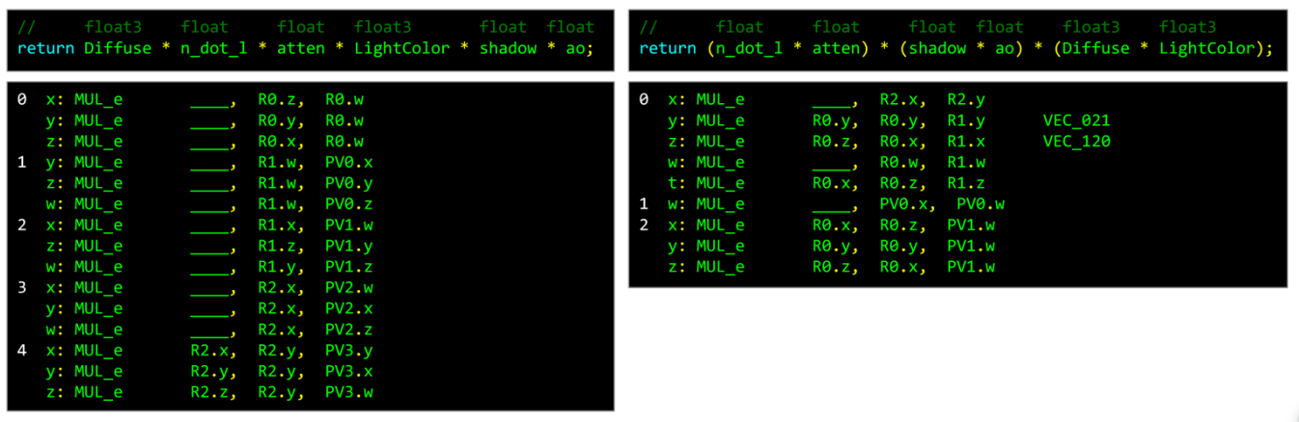
Does this really help?
Let’s look at compiled shader code
Example from Low-level Thinking in High-level Shading Languages
Reordering & adding ( )’s reduces instructions!

Slide 43
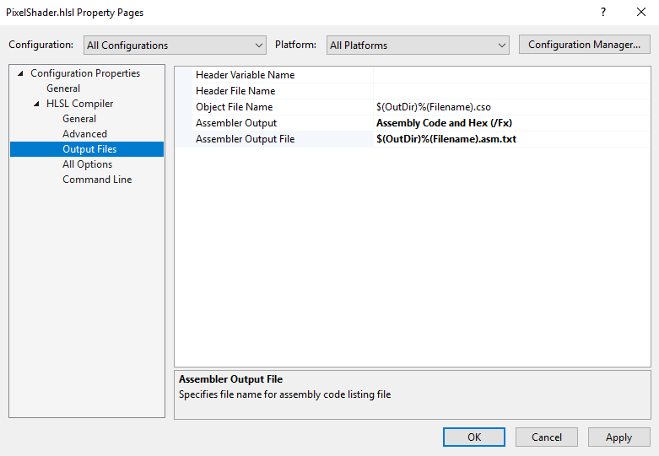
Side note: Viewing compiled code
Can look at our own compiled shader code
Outputs human-readable assembly code in .txt file
Not necessary, but possible!
Change these two options in compiler settings

Slide 44
Other improvements?
MAD!
“Multiply Add”
Special hardware instruction
Does a multiply followed by an add
Faster than two separate instructions
// Two lines with the same result
float result1 = (x + 1.0f) * 0.5f; // Multiple instructions! 😭
float result2 = x * 0.5f + 0.5f; // One instruction! 😁
A little hand-optimization goes a long way!

Slide 45
“Free” math?
Certain operations can become “free”
Won’t result in extra hardware instructions
If used properly
Absolute value
Negating a value
Saturate()

Slide 46
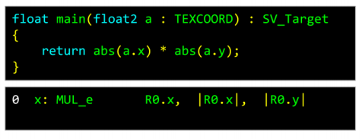
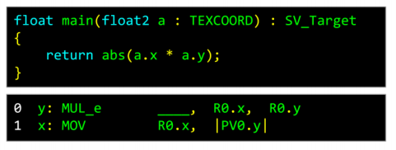
Absolute value & negative sign
Free when used on input to an expression
Extra instruction when used on output

Slide 47
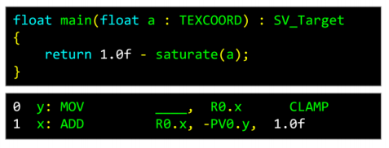
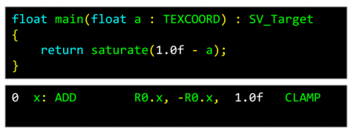
Saturate
Extra instruction when used on input
Free when used on output of an expression

Slide 48

Holy crap, this is a lot
Do we really need to go this deep?!
Nope! Especially not for this course
I wanted to show a quick peek of this depth
Major takeaways:
Do the least amount of work you can
Aim for “calculate once, reuse result”
Be cognizant of what your code is actually doing

